Slide 1
HAND GESTURE RECOGNITION
CS 415 Computer Vision I
Team members: Krishna Garg, Nitya Mula, Ramana Rao Akula

Slide 2
Problem Statement
To develop an application that can recognize the hand gestures from a live video sequence / images and accordingly perform some actions based on the gesture recognized.

Slide 3
Motivation
Gesture recognition has been a very interesting problem in Computer Vision community for a long time.
It is obvious that there is a semantic gap between how humans look at a picture and how a computer does it. Yet, there are many widely used applications in Computer vision and Human-Computer Interaction.
Applications
Gesture based video/audio controls
Robotic arm control
Sign language system for impaired people

Slide 4
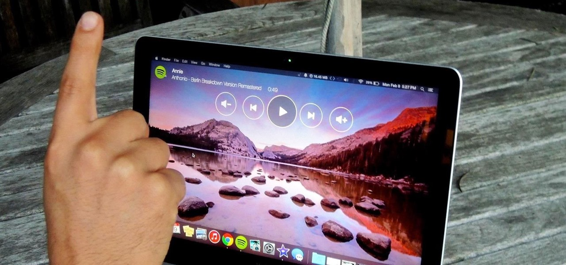
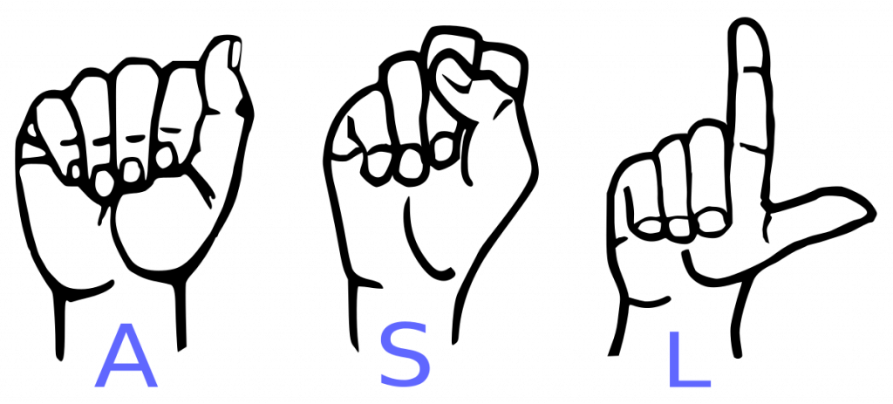
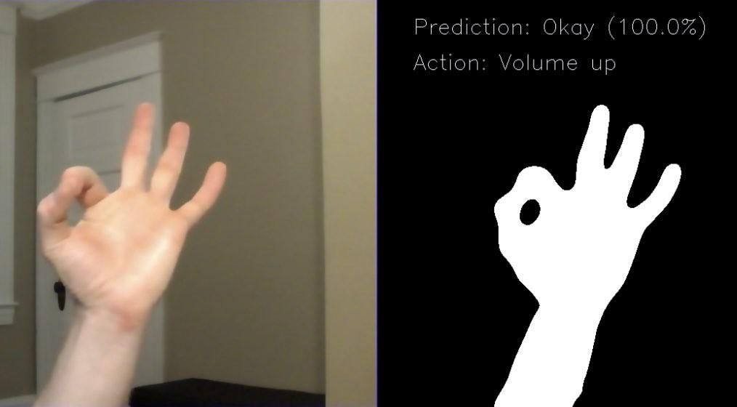
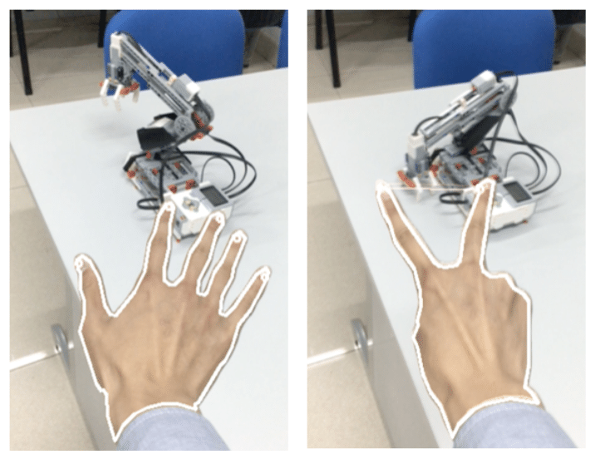
Gesture based audio/video control
Sign language system for impaired people
Robotic arm control

Slide 5
Motivation
Another important motivation is to assist the impaired using hand gesture recognition.
Today, many input devices are available for people who are able. However for the visually impaired many of these are not suitable and include a lot of limitations.
The communication for visually impaired and blind people focuses mostly upon speech or keyboard interfaces which may not be efficient enough in everyday environments.

Slide 6
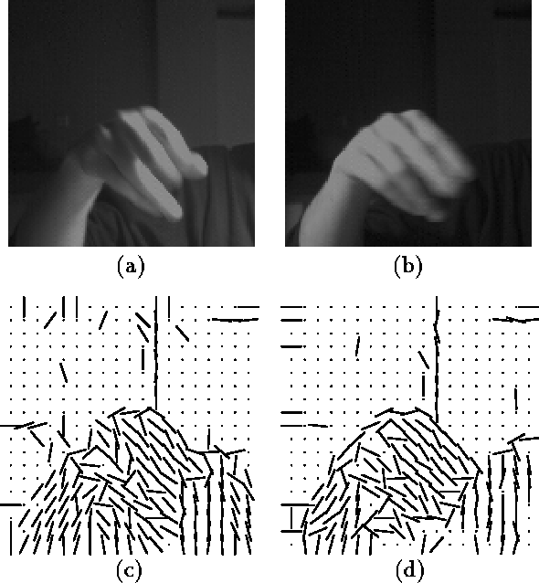
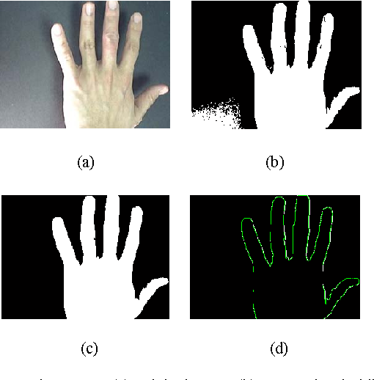
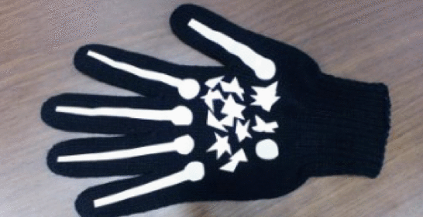
Existing approaches
The problem of hand gesture recognition can be tackled by various methods like using markers on the fingertips, orientation histograms, Fourier descriptors etc.
Monochrome Glove with markers
Orientation histograms
Fourier descriptors

Slide 7
Gesture Recognition using Contours

Slide 8
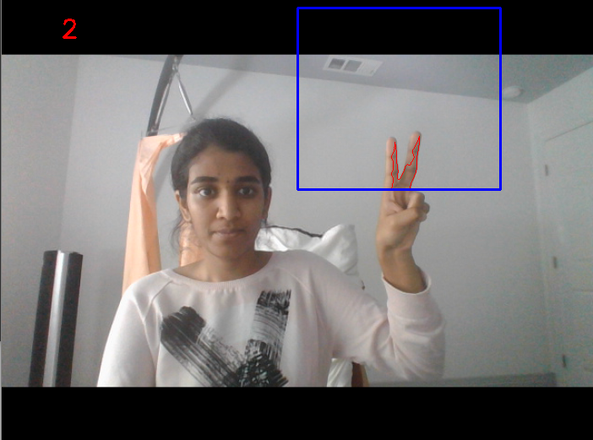
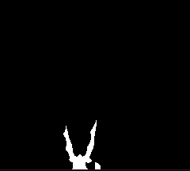
Approach 1 (using contours)
Background Subtraction and Thresholding:
Segment the hand region based on some background subtraction technique (frame differencing) using a threshold.
Contour Extraction:
We find contours in the resulting image and assume that the contour with the largest area is our hand.

Slide 9
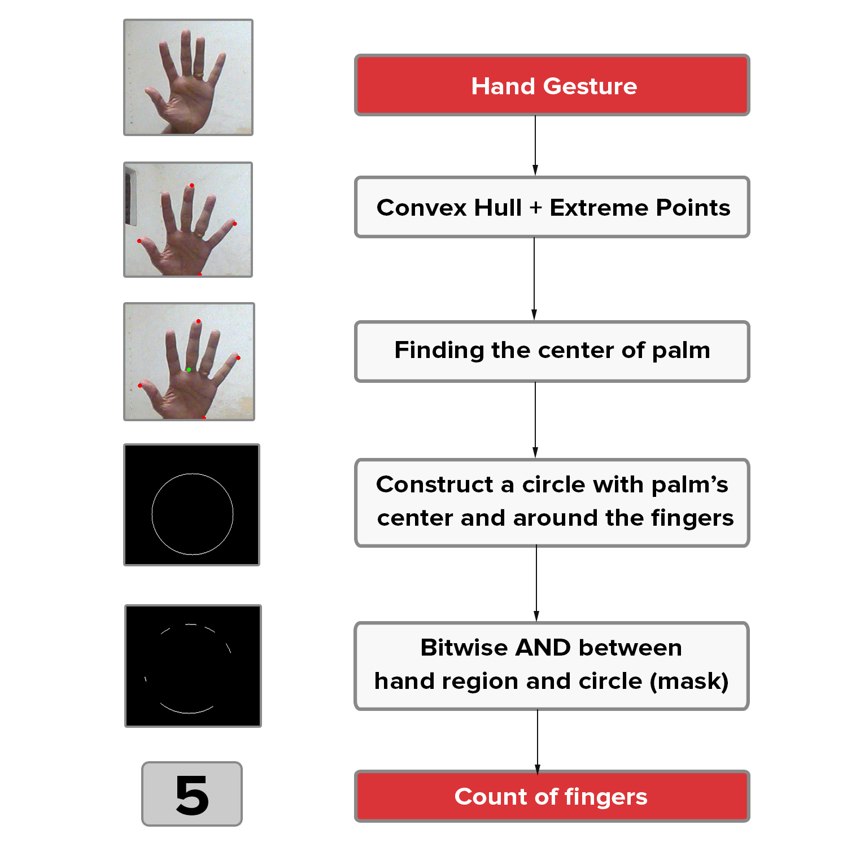

Construct a circle with center at the centroid of the contour and radius as max of euclidean distance to extreme points times some threshold.
Perform bitwise AND operation between the thresholded hand image and the circular mask obtained above. This gives the number of fingers in the frame.
Once the fingers are counted, actions can be incorporated accordingly.
Image source :https://gogul.dev/software/hand-gesture-recognition-p2

Slide 10
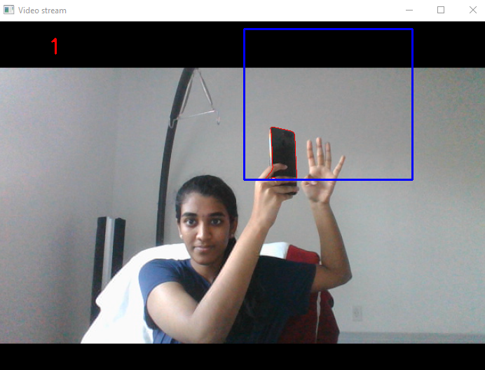
Limitations of this approach
This approach can detect only five finger counts.
Too geometric and hand-designed approach.
One assumption with this approach is that the largest contour (maximum area) in the frame is our hand.
If an object larger than the hand is brought inside the frame then this algorithm fails.

Slide 11
Gesture Recognition using Deep Learning

Slide 12
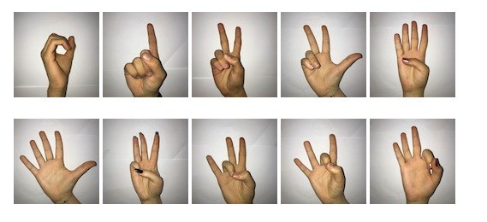
Sign Language Digits Dataset
Classes/Gestures: 0-9
Channels: 1
Image-size: 64*64
Total Images: 2062
(Roughly 205-208 samples per class)
Dataset source: github.com/ardamavi/Sign-Language-Digits-Dataset

Slide 13
Dataset Split & Preprocessing
Train | Test
1649 images (80%) | 413 images (20%)
Preprocessing
Mapping to correct gesture directories
Transformations:
Horizontal Flip
Center Crop with padding
Data Shuffling

Slide 14
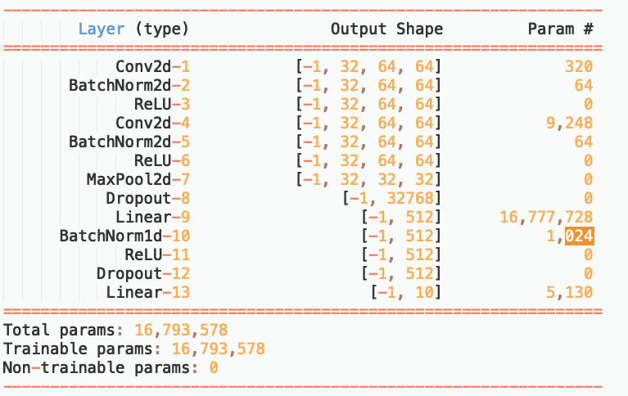
Architecture Summary

Slide 15
Parameters & Hyperparameters
Epochs: 100
Batch size: 4
Optimizer: ADAM [lr = 0.01]
Scheduler: StepLR [step_size=7, gamma=0.1]
Loss function: Cross entropy

Slide 16
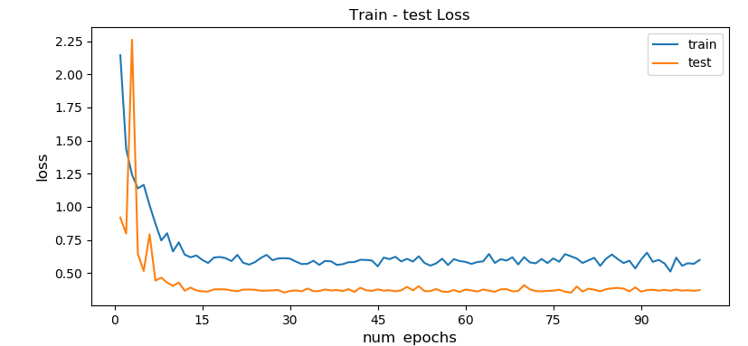
Plots(1) - Loss vs Epochs

Slide 17
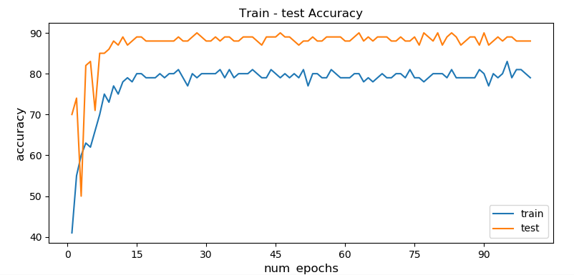
Plots(2) - Accuracy vs Epochs

Slide 18
We are halfway through...
Approach 1: Mapping gestures to operate video to PLAY, PAUSE, STOP, FAST-FORWARD, SKIP 10 sec, etc.
Approach 2:
More experiments for hyperparameter tuning
Learning rate
Architectures
N-fold validation

Slide 19
Some challenges we faced
Running it using GPU
Keeping track of tensors’ dimensions and type

Slide 20
Changes after the presentation
Using a custom model on the sign language digits dataset had some bad results with testing accuracy being greater than training accuracy.
This was improved by using pre defined models by ResNet152, VGG16, InceptionV3, ResNet50.
However, the dataset gave the same results on the pre trained models as well so we had to change the dataset.

Slide 21
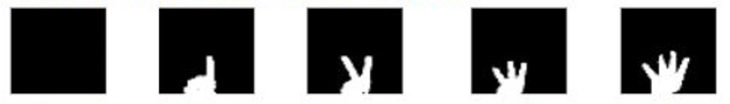
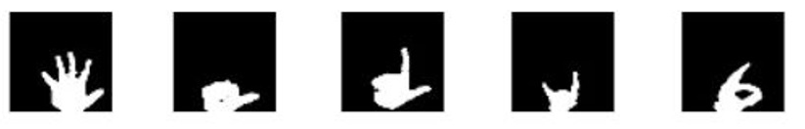
New dataset - Hand Gesture dataset
Dataset source: github.com/ardamavi/Sign-Language-Digits-Dataset
Gesture 0
Gesture 1
Gesture 2
Gesture 3
Gesture 4
Gesture 5
Gesture 6
Gesture 7
Gesture 8
Gesture 9

Slide 22
Train | Test
1000 images per gesture | 50 images per gesture
Classes/Gestures: 0-9
Image-size: 224*224*3
Preprocessing
Mapping to correct gesture directories
Transformations:
Data Shuffling

Slide 23
Parameters and Hyperparameters
Epochs: 20
Batch size: 4
Optimizer: SGD
Momentum: 0.9
Loss function: Categorical cross entropy
Learning Rate: 0.01[ResNet50, RestNet152], 0.0001[InceptionV3, VGG16]

Slide 24
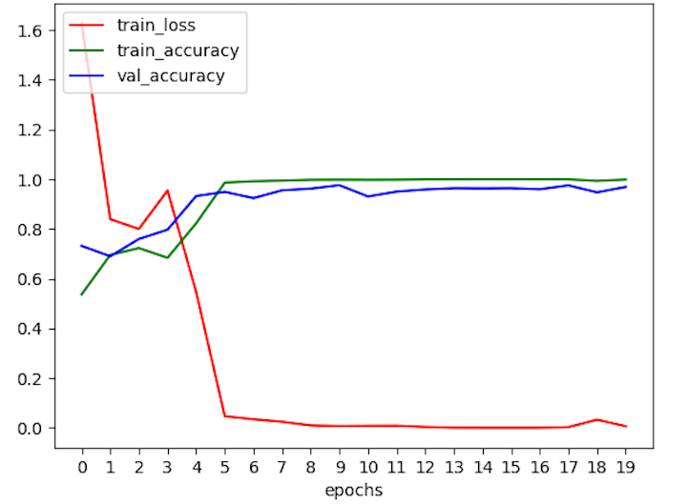
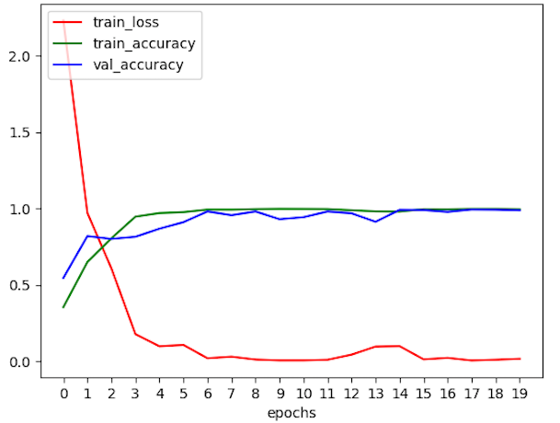
ACCURACY vs EPOCHS
ResNet50
ResNet152

Slide 25
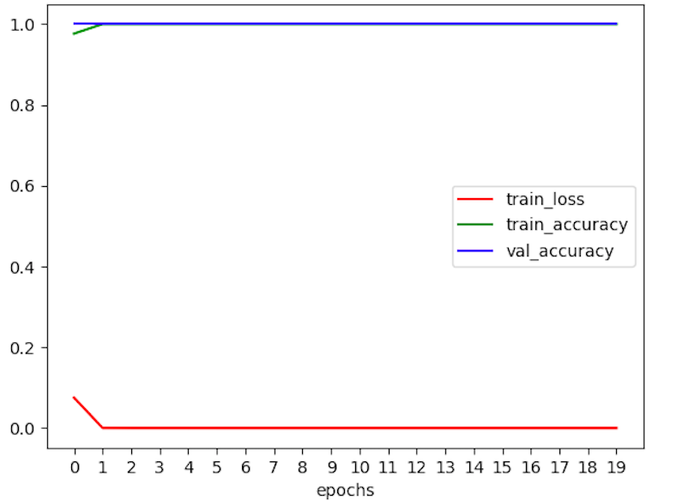
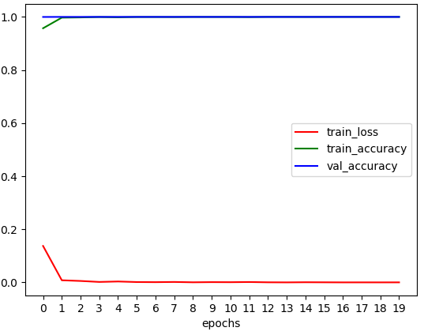
ACCURACY vs EPOCHS
VGG16
InceptionV3

Slide 26
RESULTS
Models | Training accuracy | Testing Accuracy
ResNet50 | 99.88% | 85.04%
ResNet152 | 99.58% | 87.21%
VGG16 | 100% | 96.84%
InceptionV3 | 100% | 94.85%

Slide 27
Conclusion
The approach using contours is geometry based and performs fairly.
However it is not sophisticated enough and has many limitations.
These limitations do not seem to occur when we use the deep learning models.
Out of all the models we experimented on, we observe that VGG16 performed the best.

Slide 28
Contributions of team members
Ramana Rao Akula, Nitya Mula and Krishna Garg: Approach 1 using contours
Krishna Garg, Nitya Mula and Ramana Rao Akula: Approach 2 using Deep Learning

Slide 29
Thank you!
Questions please...

